Slide 1
Data Fest

Slide 2
Bacterial Data
6 Species
Staphylococcus aureus (MSSA), Corynebacterium striatum (Corn), Pseudomonas aeruginosa (PAO), Escherichia coli (E. coli), Enterococcus faecalis (FAE), Stenotrophomonas maltophilia (Malt)
100 Spectra per species per sample
4 total samples done per species
400 spectra per species → 2400 total
Data Cleaning/Preprocess
Outlier Removal → <Q1 = median, >Q3 = median
Min-Max Normalize

Slide 3
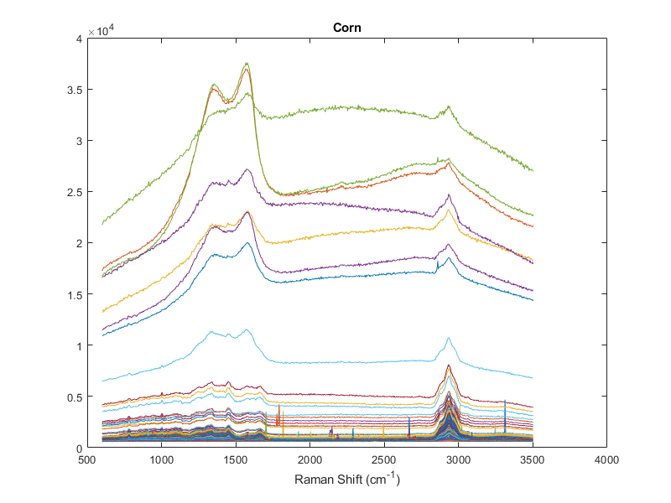
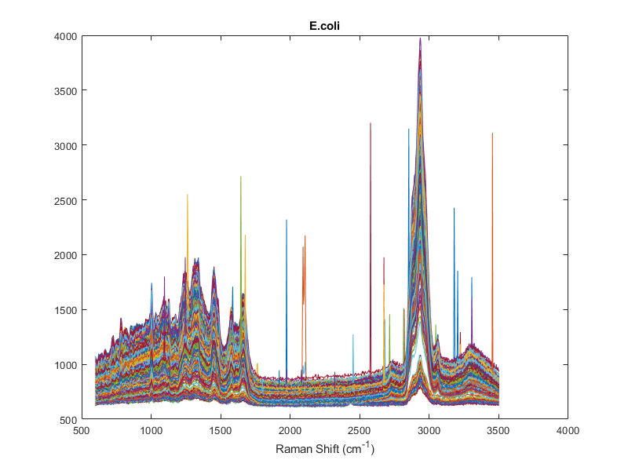
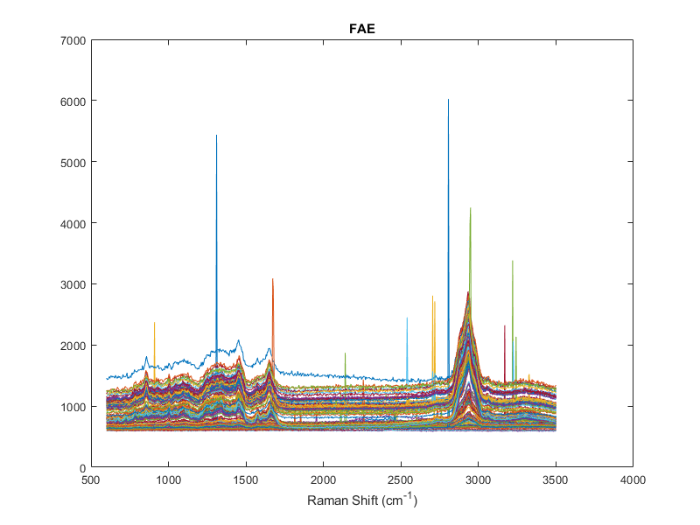
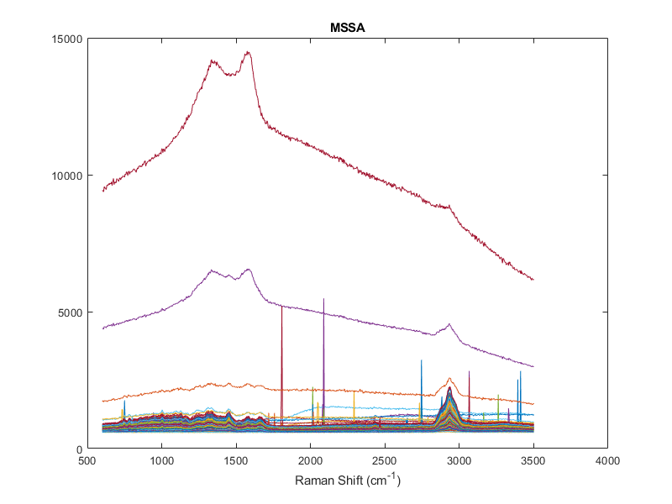
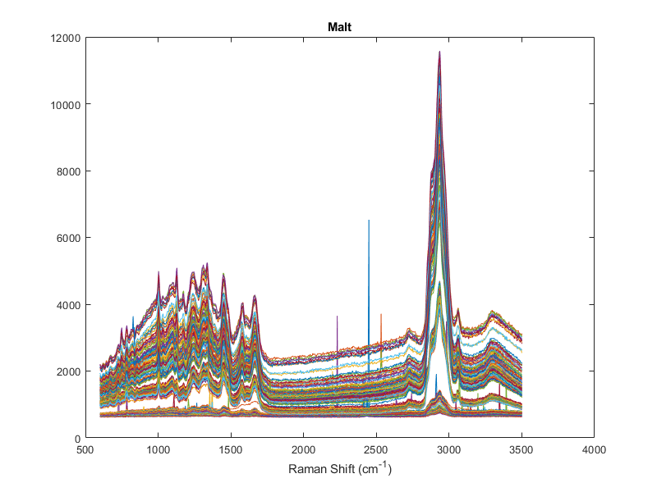
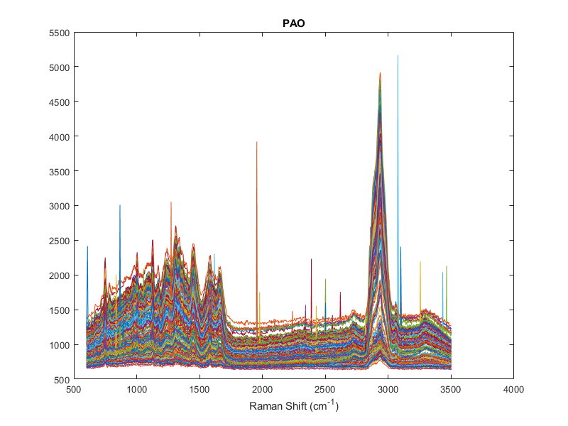
Raw Raman Plots

Slide 4
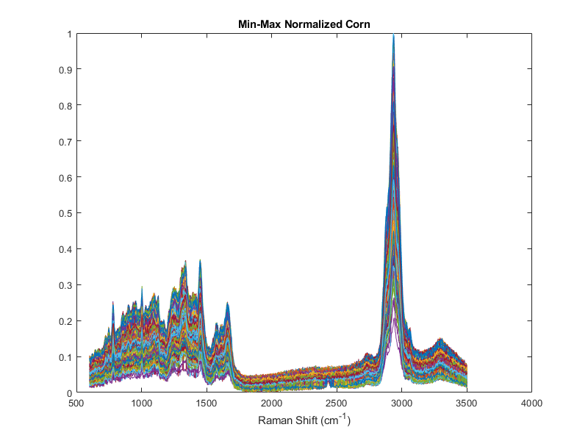
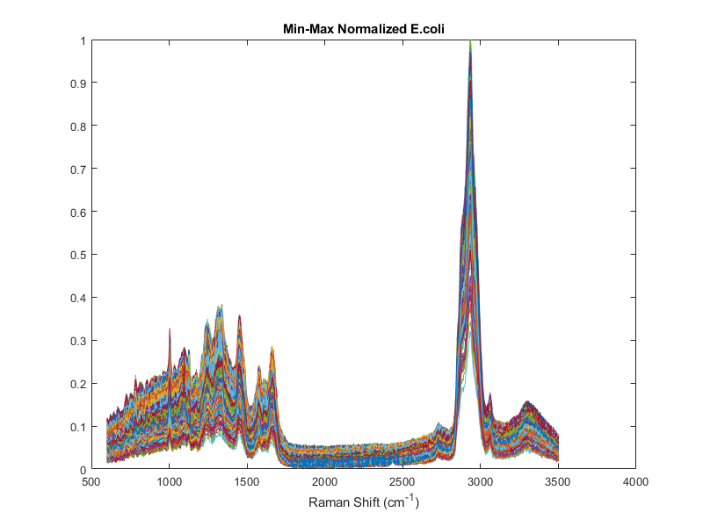
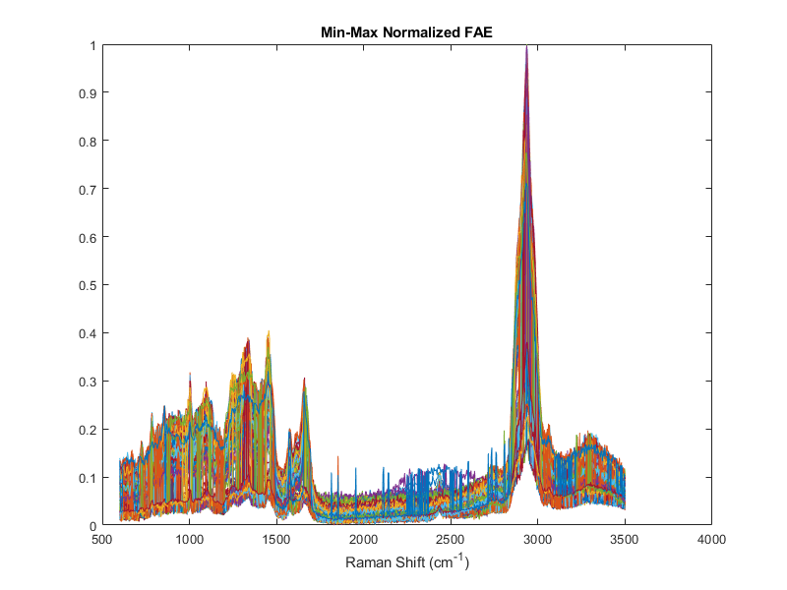
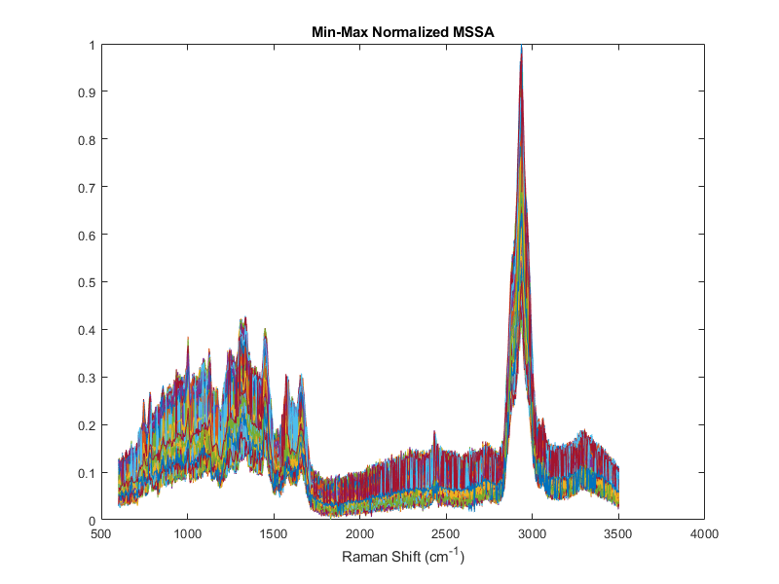
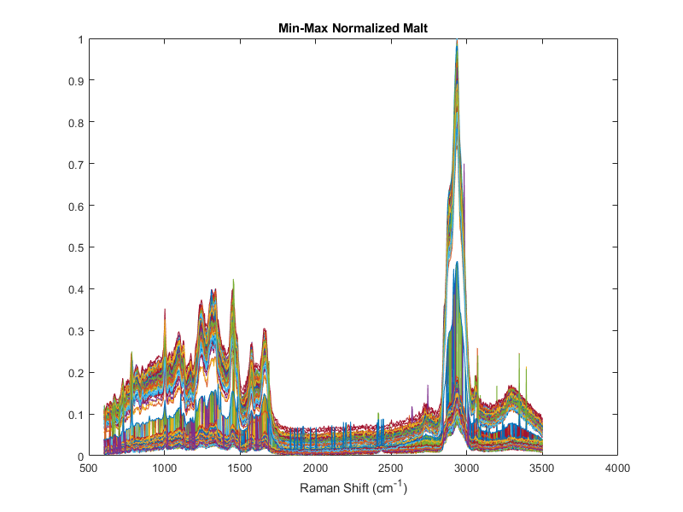
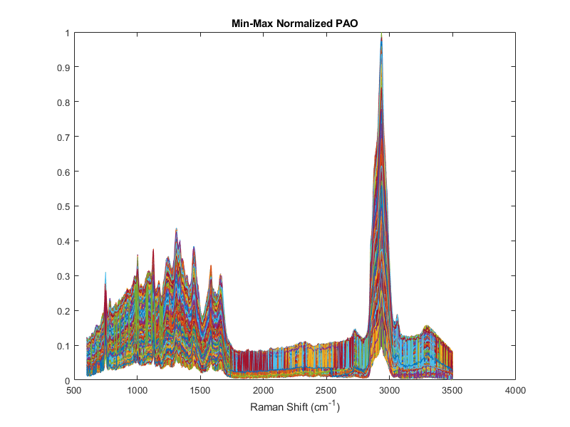
7
Normalized, cleaned Spectra, <Q1, >Q3 = median

Slide 5
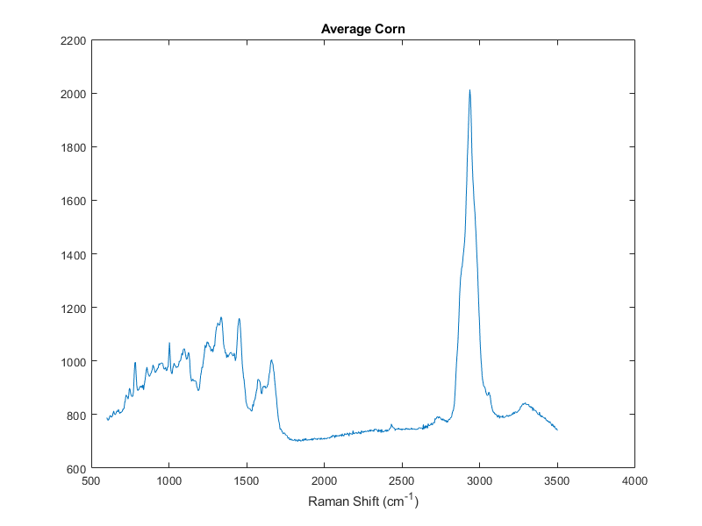
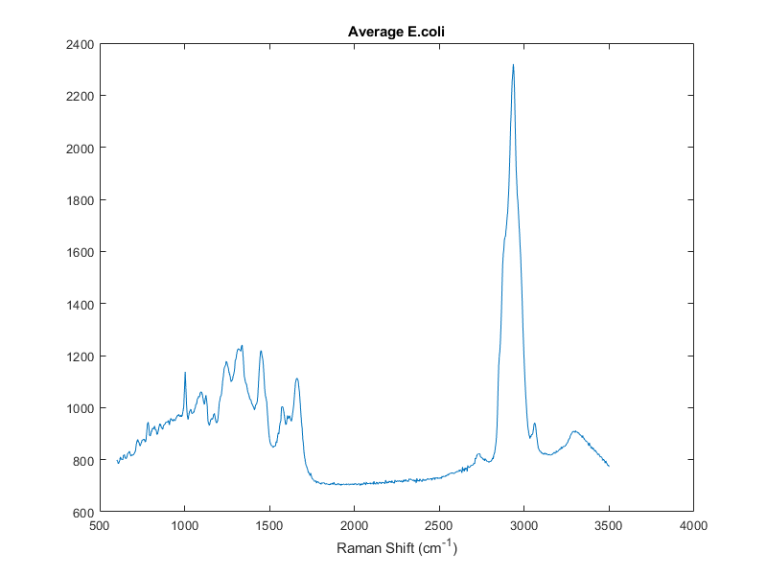
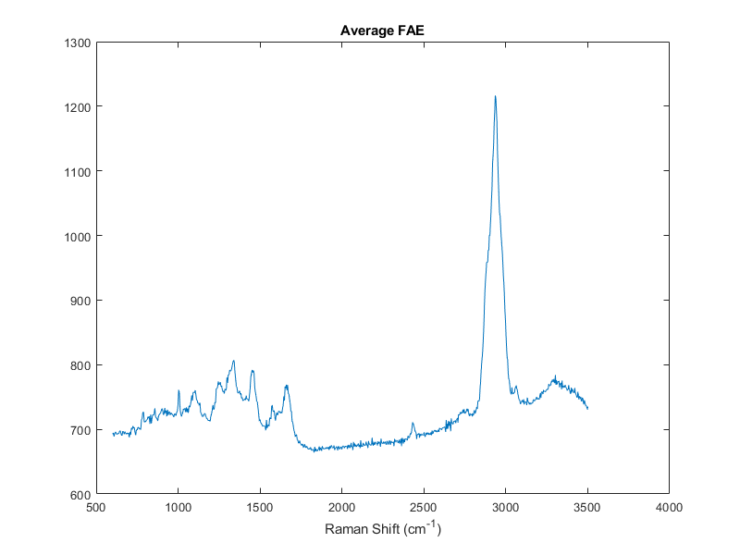
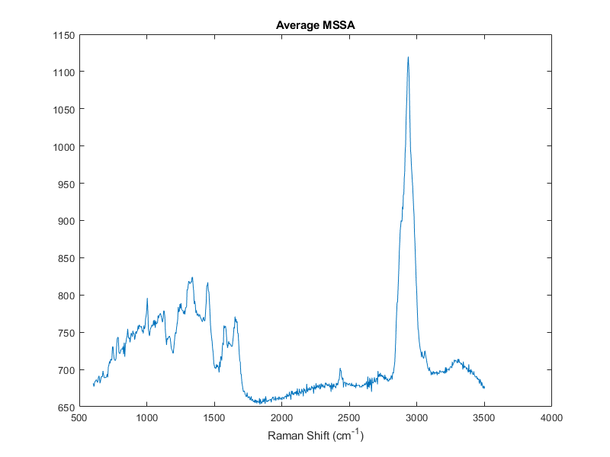
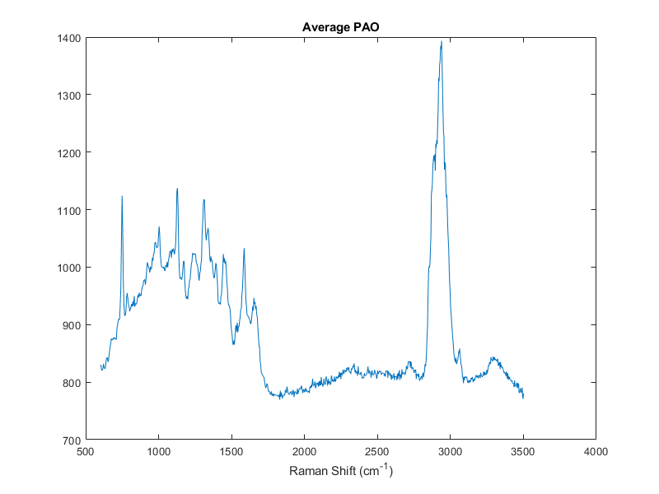
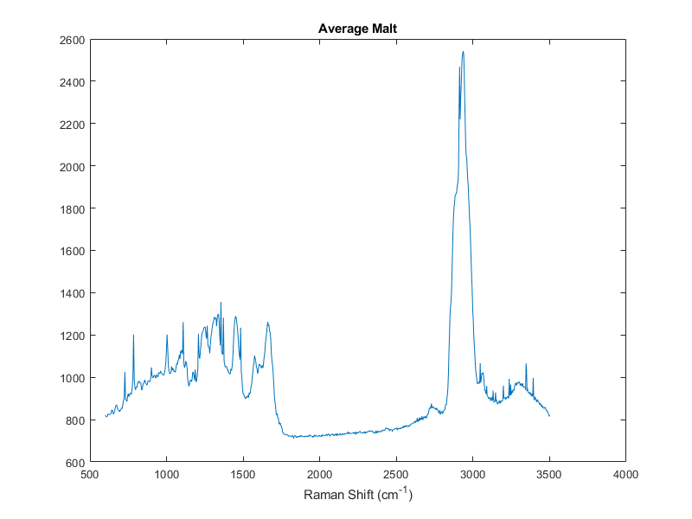
Median Spectra Plots

Slide 6
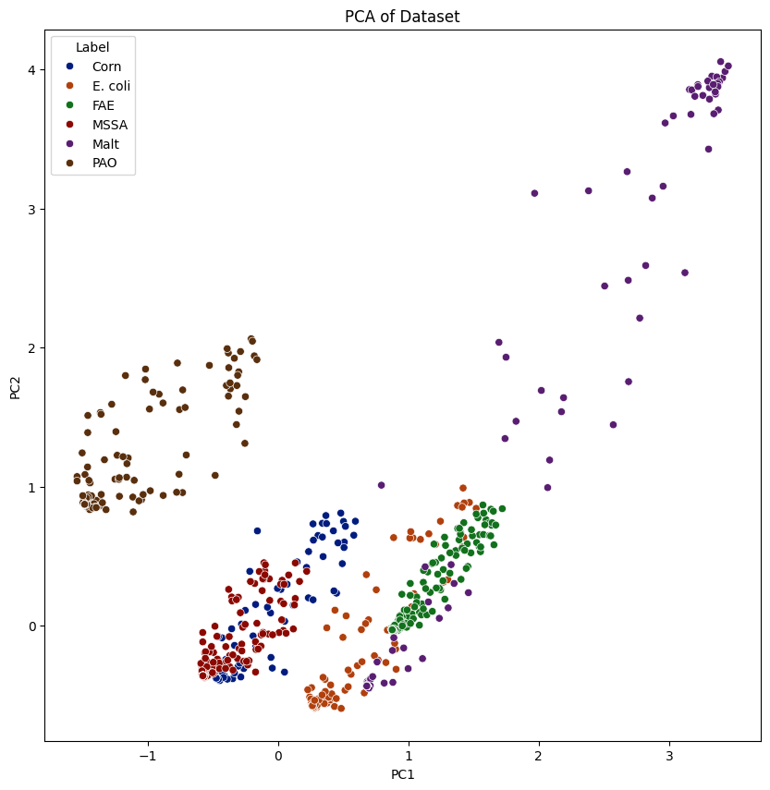
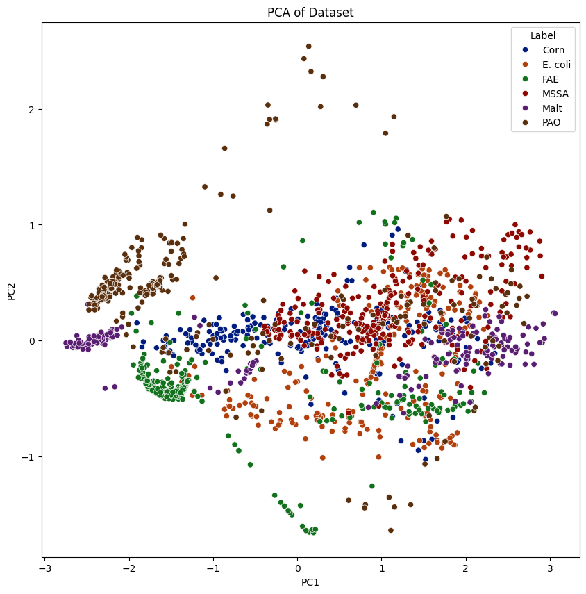
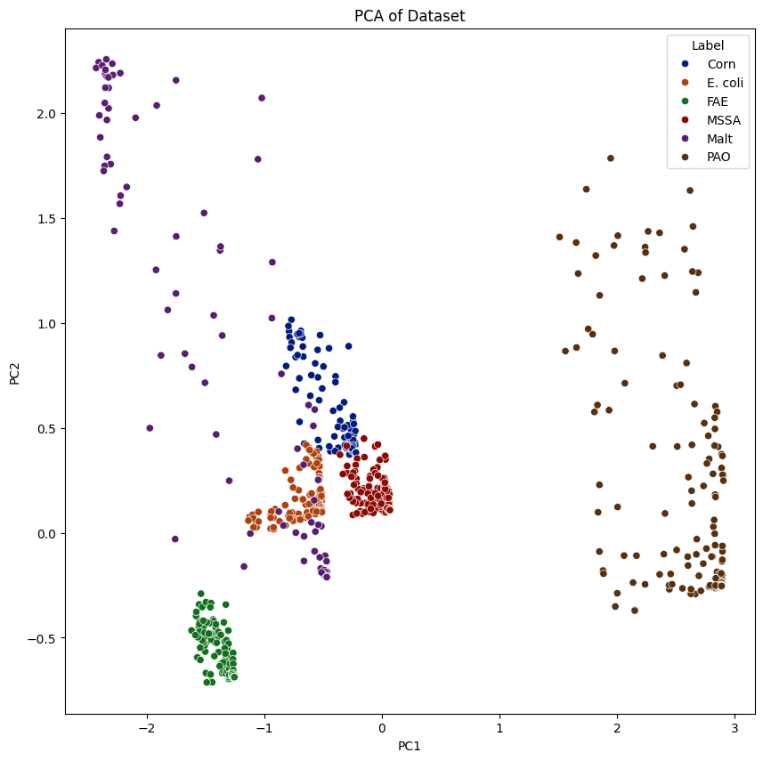
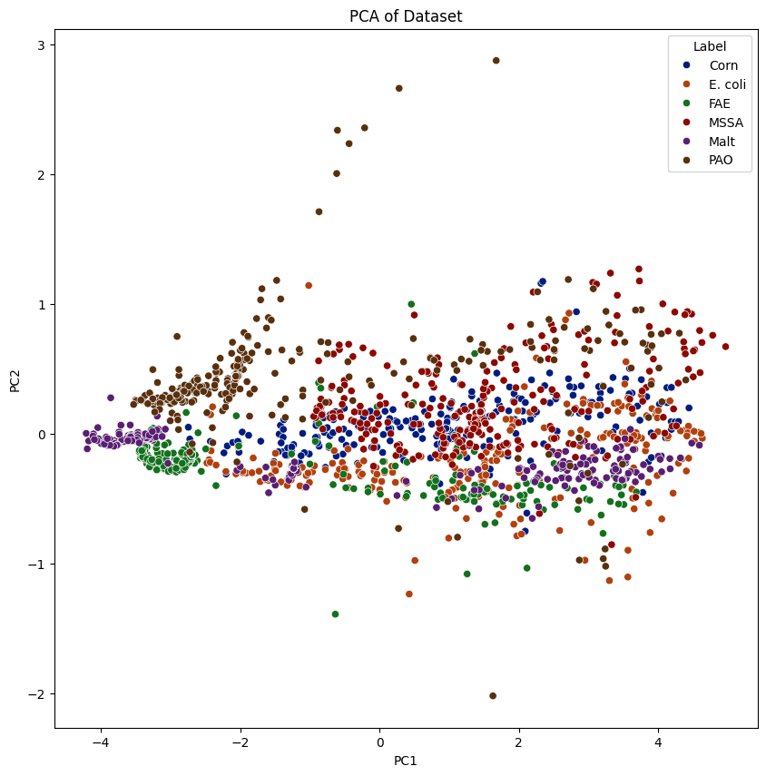
PCA: 400 spectra per species <40%, >50% = median
2nd PCA done: 100-200 Spectra per species
<Q1, >Q3 = median
PCA: 400 Spectra per species
<Q1, >Q3 = median
PCA Fingerprint region: 400 Spectra per species, <Q1, >Q3 = median
PCA Fingerprint: 400 Spectra per species, <40%, >50% = median

Slide 7
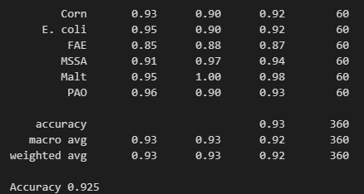
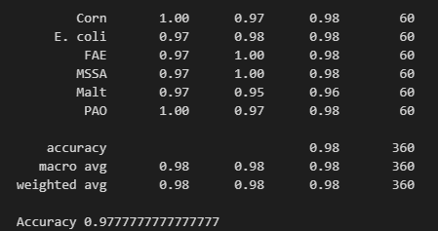
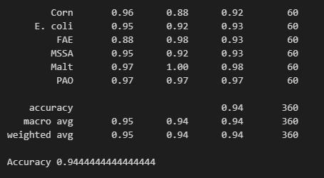
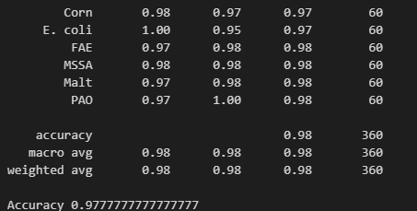
Classification Entire Spectra
<Q1, >Q3 = median dataset, training = 70%, test = val. = 15%
Decision Tree | Random Forest
Validation:
Test:

Slide 8
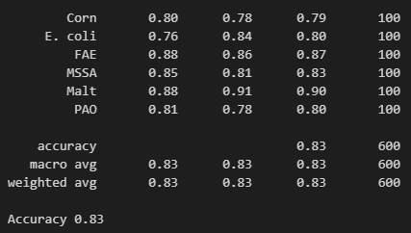
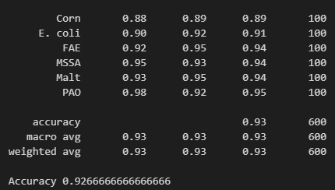
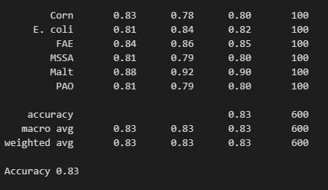
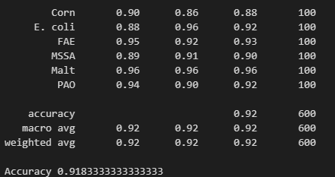
Classification Again Entire Spectra
>90% = median dataset, training = 50%, test = val. = 25%
Decision Tree | Random Forest
Validation:
Test:

Slide 9
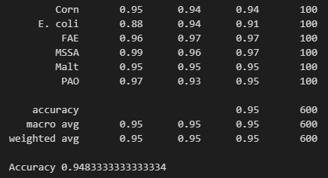
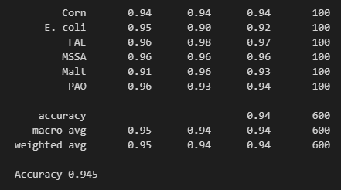
Classification Again Fingerprint region
<Q1, >Q3 = median dataset, training = 50%, test = val. = 25%
Random Forest
Validation:
Test:

Slide 10
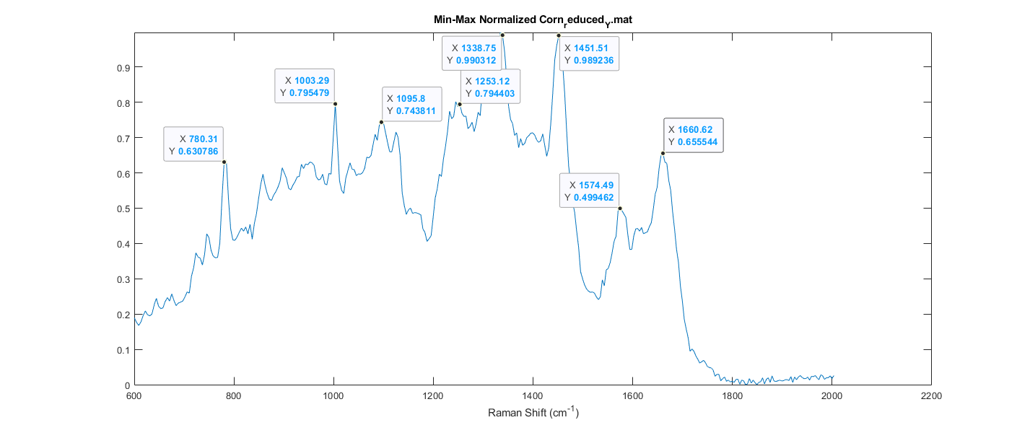
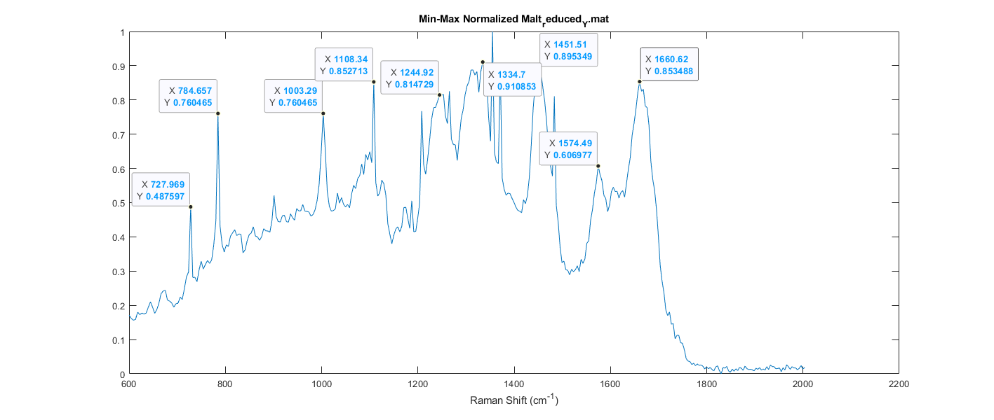
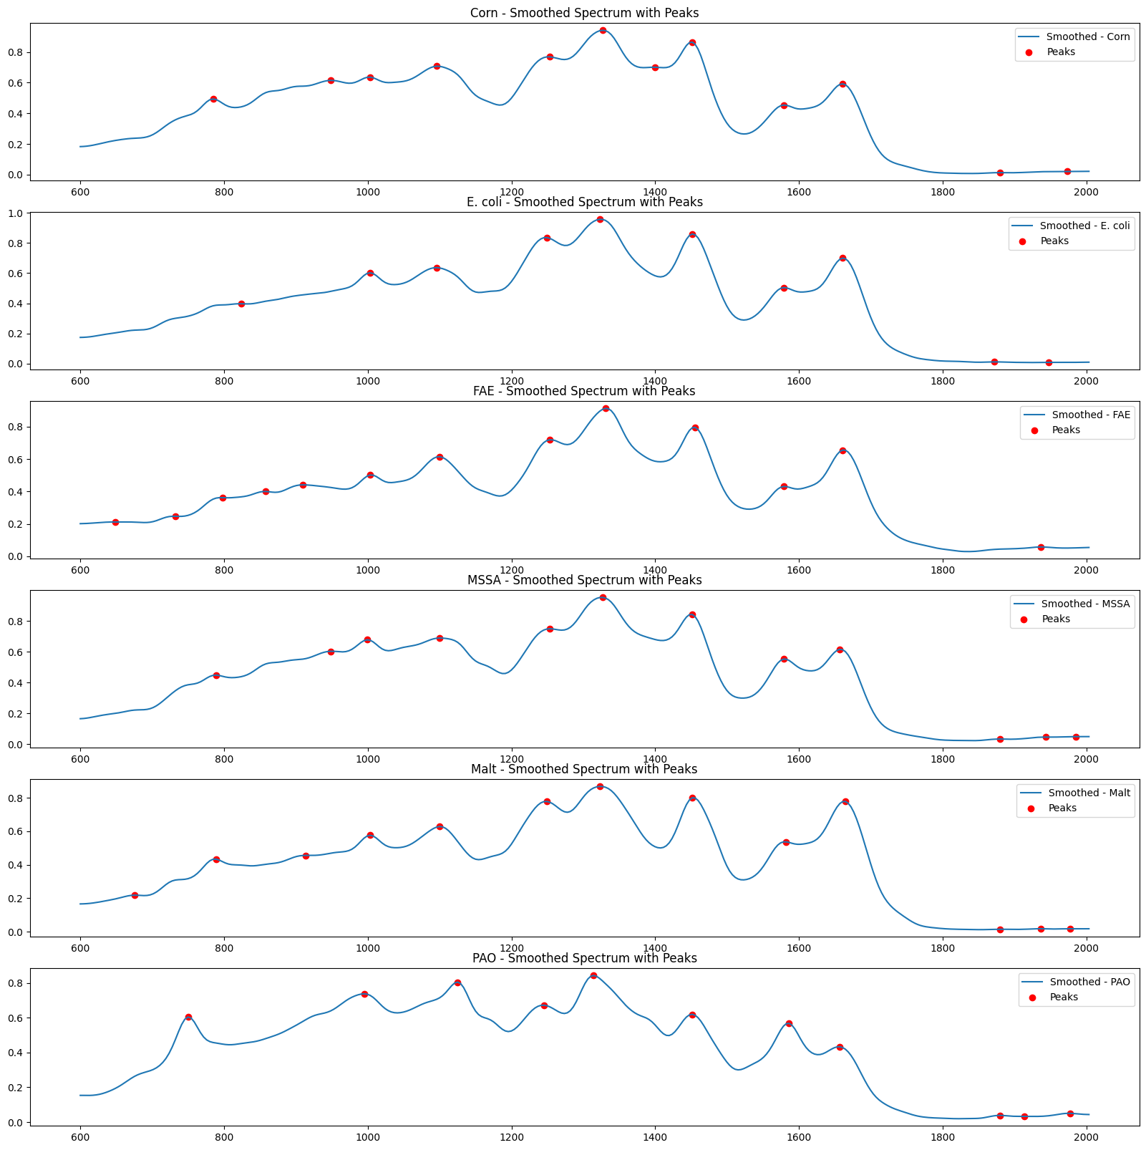
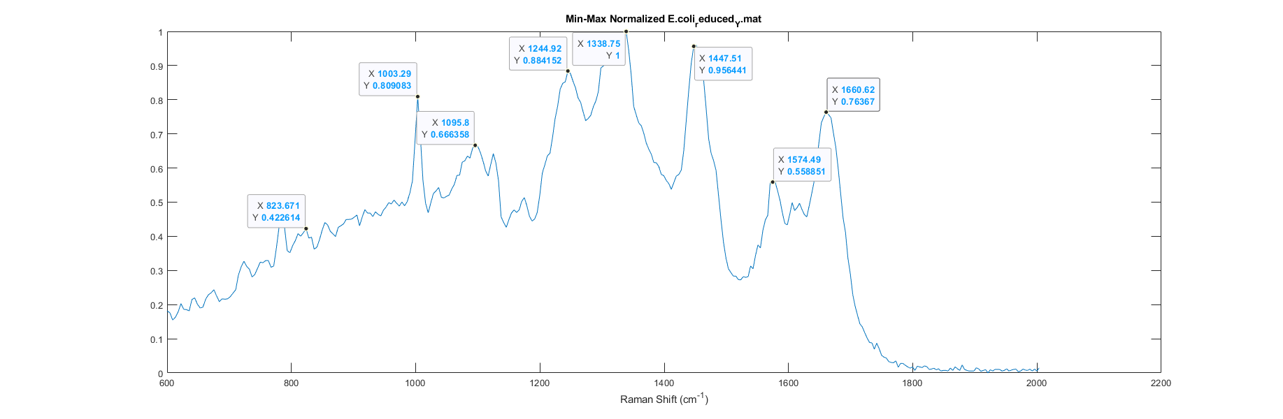
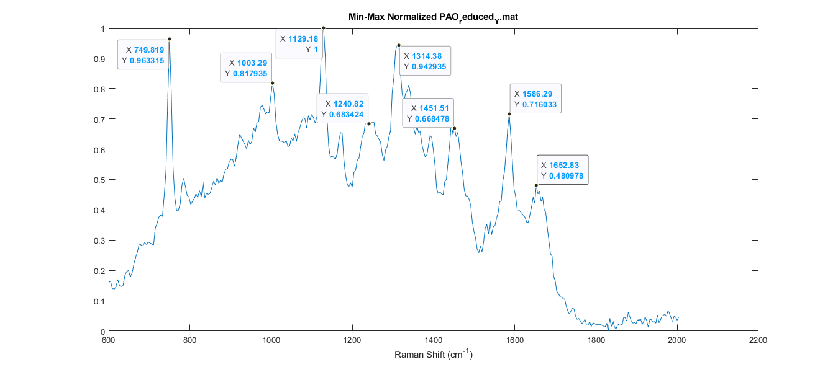
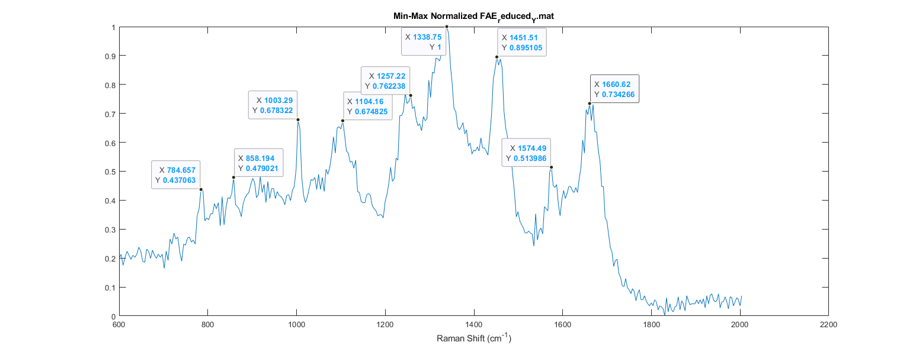
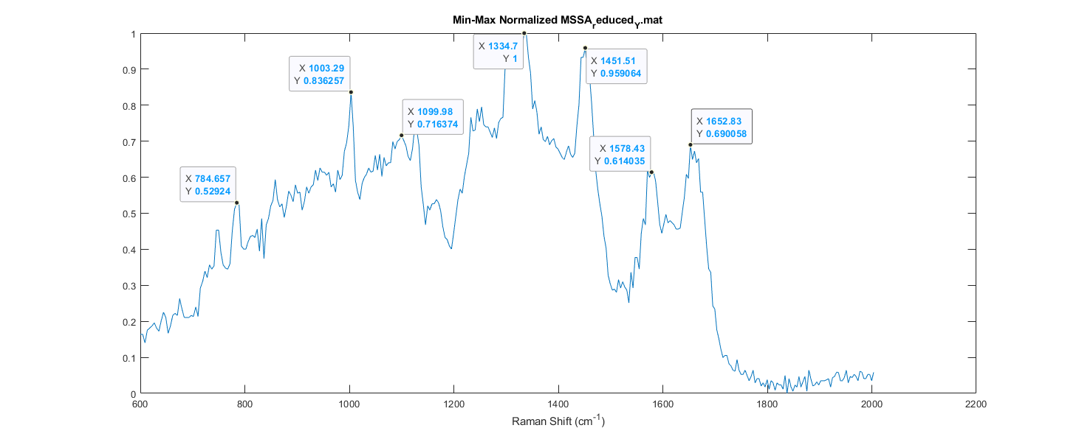
Fingerprint region Peak Points (median)
Common Peaks: 1003 (Phenyl Protein..I think), 1335 (Nucleic Acid/DNA, CH2 wagging, 1600 – 1800 amide 1, 1470 – 1570 amide 2, 1250 – 1350 amide 3

Slide 11
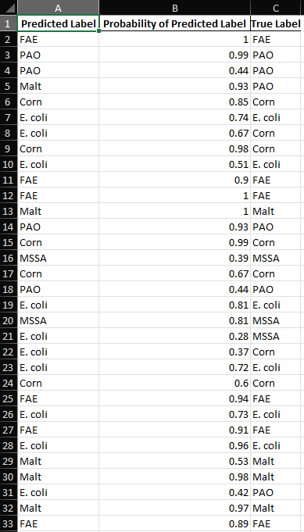
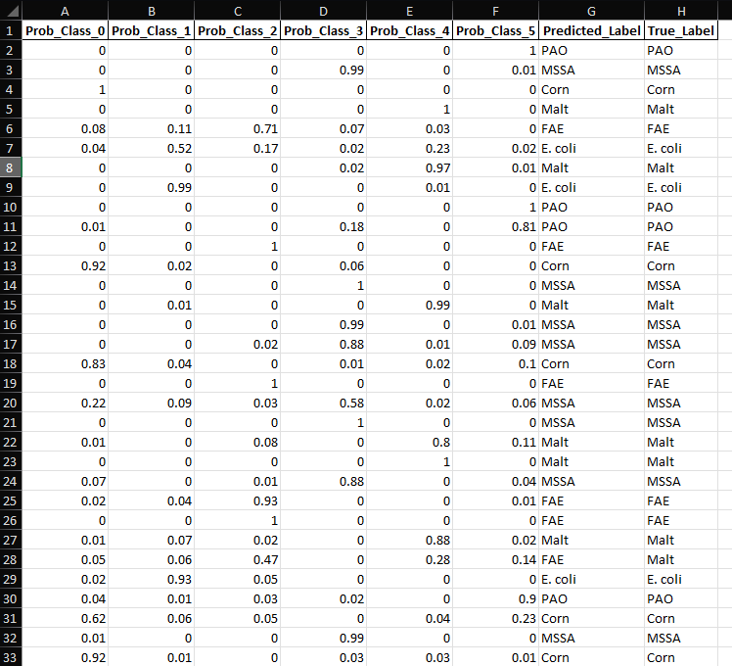

Slide 12
Classifying Co-Cultured

